Slide 1
MTB Handbook
v1.1
Chris Styles

Slide 2
MTB Handbook
Overview
DAPlink
Module Carrier
Power
Onboard peripherals
Grove connectors
Loopback testing

Slide 3
Overview

Slide 4
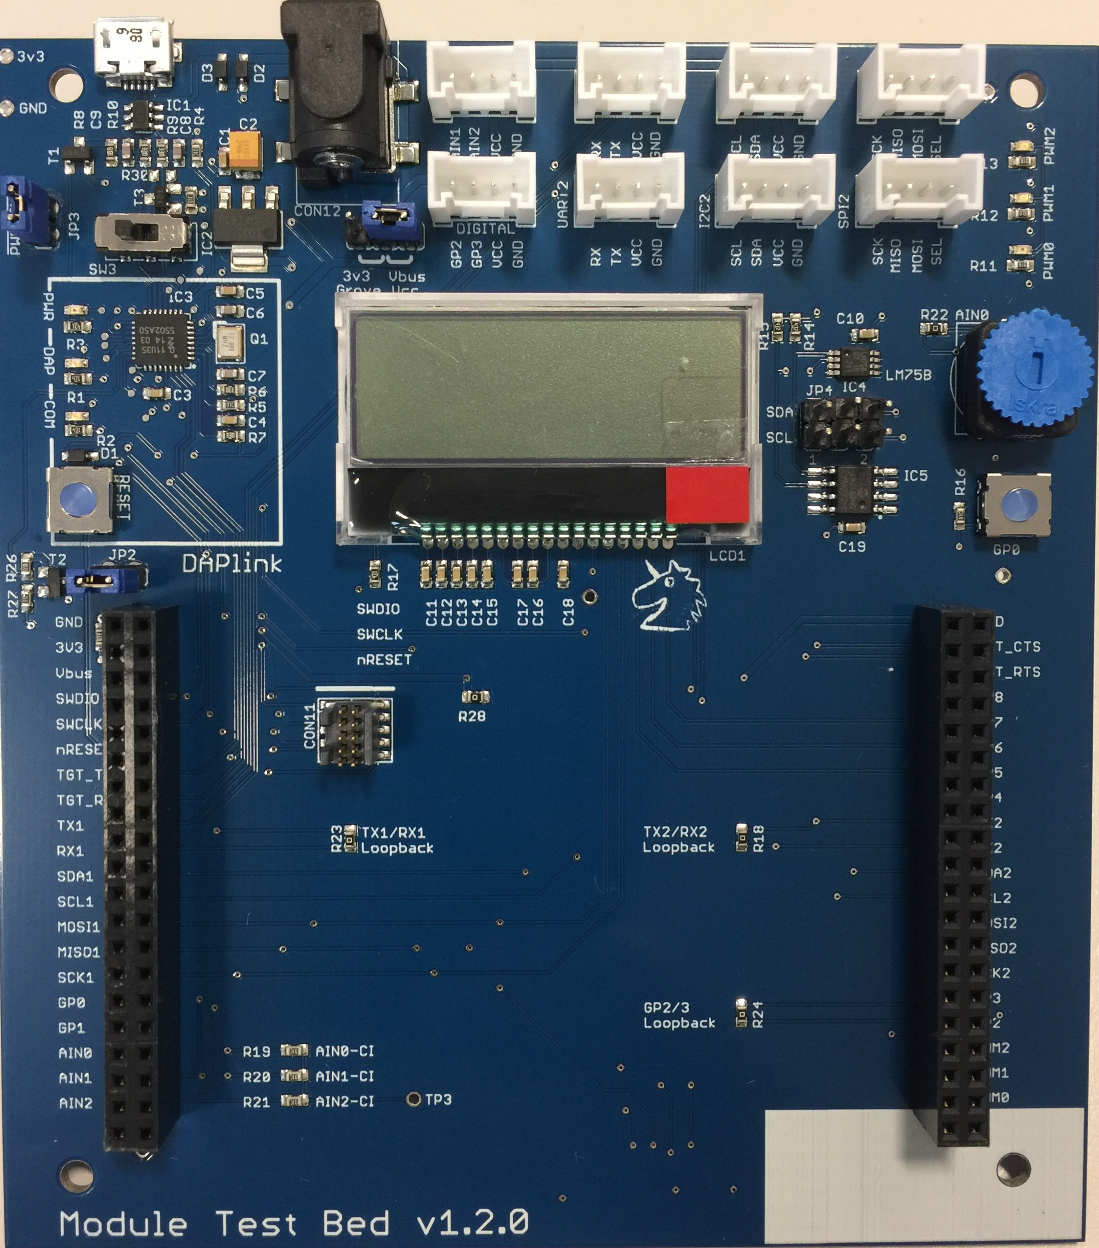
Overview
External DC power
DAPLink Micro USB
Grove Sockets
MTB Power Enable
Power switch
Grove Voltage selector
I2C Temperature sensor
DAPLink LEDS
Potentiometer
DAPLink Reset
I2C bus select
Button
128 x 32 LCD
Module Carrier Socket

Slide 5
DAPLink

Slide 6
DAPLink
LPC 11U35
SWCLK/SWDIO
Module
USB Serial (stdio)
nRESET
USB MSC (Drag and drop)
USB HID (Debug)
TGT_TX / TGT_RX
Updating the DAPLink firmware:
Plug in your MTB, holding down the reset button, a drive called CRP Disabled will enumerate
Open the drive, and delete the file called "firmware.bin"
Copy the required .bin file onto the "CRP Disabled" drive.
On Windows, simply drag and drop the file
On Linux/Mac, use command: dd if={new_firmware.bin} of={firmware.bin} conv=notrunc
Disconnect and reconnect the MTB, it should now enumerate as drive called “DAPLink”
Note : For drag and drop programming to work, the correct .bin files has to be used, as it will need ot contain the flash algorithm for the target device

Slide 7
Module Carrier

Slide 8
3v3 @ 250mA
GND
GND
3v3
TGT_RTS
DAPLink
VBUS
TGT_CTS
DAPLink
SWDIO
GP8
SWCLK
GP7
LCD : nCS
nRESET
GP6
LCD : nRST
TGT_TX
GP5
LCD : A0
TGT_RX
GP4
GROVE
TX1
TX2
GROVE
RX1
RX2
GROVE / Onboard
SDA1
SDA2
GROVE / Onboard
SCL1
SCL2
SD / LCD / GROVE
MOSI1
MOSI2
GROVE
MISO1
MISO2
SCK1
SCK2
Button
GP0
GP3
GROVE
GP1
GP2
SD : nCS
Pot
AIN0
PWM2
Green LED
Grove
AIN1
PWM1
Blue LED
Grove
AIN2
PWM0
Red LED

Slide 9
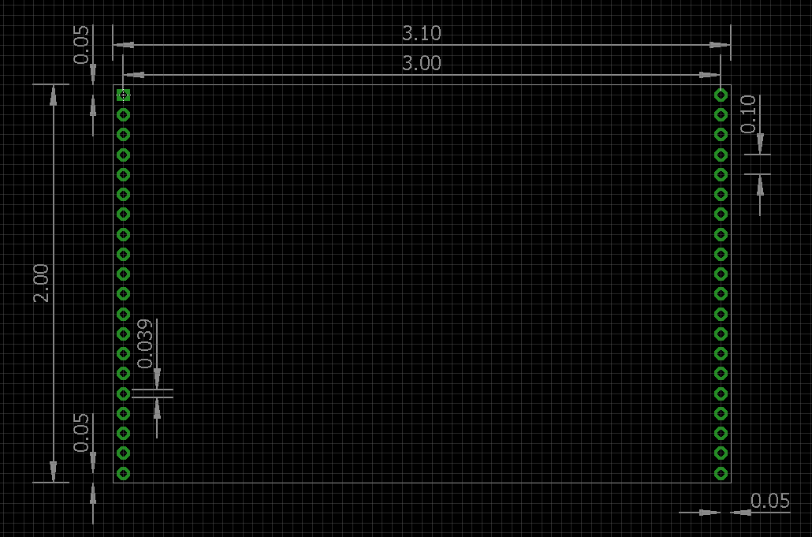
Module Carrier
All units in inches
3.1” x 2.0” board
2 x 20 way, 0.1” pitch headers spaced 3.0” apart
0.039” diameter holes
Board edge 0.05” from the hole centres

Slide 10
Module Carrier Notes
The VBUS supply is from the DAPlink USB socket, and is nominally 5v
The maximum combined current draw from VBUS and 3v3 must not exceed 250mA
Modules Carriers that are likely to cause large current spikes (RF transmit, for example), should have their own power supply

Slide 11
Power

Slide 12
Power Scheme
External DC
5v-9v, tip positive
MTB v1.2.0
MTB power gate
Manual Switch
USB Power
Jumper Pin

Slide 13
Onboard peripherals

Slide 14
Onboard peripherals : LCD
128 x 32 LCD
MOSI1
SPI
MISO1
SCK1
GP7
nCS
GP6
nRST
GP5
A0

Slide 15
Onboard peripherals : SD Card
Micro SD
MOSI1
SPI
MISO1
SCK1
GP2
nCS

Slide 16
Onboard peripherals : I2C devices
AT24LC256 EEPROM
Addr : 0xA0
LM75B Themometer
Addr : 0x90
I2C bus select
SDA1
SCL1
SCL/SDA
SDA2
SCL2

Slide 17
Grove Connectors

Slide 18
Grove connectors
MOSI1
CON1
SDA1
CON5
MISO1
SCL1
SCK1
3.3v
TX1
CON2
TX2
CON6
VCC_GROVE
RX1
RX2
5v
AIN1
CON3
MOSI2
CON7
AIN2
MISO2
SCK2
Grove voltage selector
GP3
CON4
SDA2
CON8
GP2
SCL2

Slide 19
Loopback testing

Slide 20
Loopback testing
To reuse the basic tests written for the “CI Sheild”

